Slide 1
Spark!
By Allan Dias
and Kathryn Garforth

Slide 2
Presentation Agenda
Section 1
Case Studies and Theories Inspiring Program Content and Delivery
Section 2
Program Overview

Slide 3
Section 1
Case Studies and Theories Inspiring Program Content and Delivery

Slide 4
Overview of Case Studies and Theories
School Failure Theory
Strategic Content Learning
Predictors of Success in Students with Learning Disabilities (LD)
Fostering Resilience in Disengaged Youth
Creating a Context for Success

Slide 5
School Failure Theory
“Students with learning disabilities experience either school failure or school problems and failure causing a negative self-image leading to school dropout, suspension and delinquency.”
Quinn, M. M. et al (2005)

Slide 6
Strategic Content Learning
Integrate support for self-regulation into instruction
Student as active interpreters (filters of information)
Learning in {career development} as guided reconstruction
Learning in pursuit of a goal
Butler, Deborah L., Beckingham, Beverly, & Novak Lauscher, Helen J. in 2005.

Slide 7
Predictors of Success in Individuals with LD
Goldberg, Higgins, Raskind, and Herman (2003)
Notes:
- These attributes were extracted after reviewing interviews of 41 students who attend a private institution in California. Two interview sessions took place at 10 and 20 year after these individuals had left the institution

Slide 8
Fostering Resilience in Disengaged Youth
Study
Two 18 year old disengaged students participated in a Work-Based Education Program (WBE).
Conclusions
Risk and resilience were shown to be context specific suggesting at risk youth may require tailored workplace programs
Keys to Successful Programs
Planning for leadership, social support, and
communication
DeLuca, Hutchinson, DeLugt, Beyer, Thornton, Versnel, Chin and
Munby (2010)
Notes:
The three components identified as key to creating a successful environment were planning for leadership, social support and communication.

Slide 9
Creating a Context for Success
Study
Two adolescents with LD who participated in a WBE and were judged as unsuccessful by their supervisors.
Conclusions
Themes that are central for WBE success :
Negotiating Accommodations
Routines
Expectations are managed
Preparation of student and employer
Versnel, Hutchinson, Munby and Chin (2008)

Slide 10
Section 2
SPARK!

Slide 11
Program Overview
General Learning Goal
Referral and Interview
Workshop Series
1. Knowing Yourself and Your Disability
2. Job Hunting and Resume Building
3. Interview Skills
4. Excelling in the Workplace
5. Internship Recap
Internship

Slide 12
Program Context
Option A:
Incorporated into the high school curriculum
Option B:
As part of a community based program

Slide 13
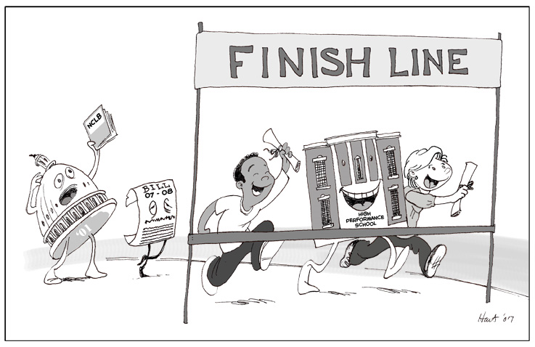
General Learning Goal
Participants will be better equipped to market themselves to employers and adapt and communicate their disability in a workplace setting thus helping them reach their overall career goals.

Slide 14
Target Audience
Transition-aged youth
In the juvenile corrections system for petty crime offences
With an LD
Not suffering from alcohol and or drug addiction

Slide 15
Referral and Interview
Participants must have several of these traits:
Self-awareness
Proactivity
Perseverance
Appropriate Goal Setting
Effective Use of Social Support
Emotional Stability/ Coping Strategies
Referrals taken from social workers and parole officers.
Referrals will be interviewed to ensure the program will be able to meet their needs.
Notes:
For this program we rely on referrals from social workers and parole officers to recommend appropriate candidates for what this program offers.

Slide 16
Workshop 1 - Know Yourself and Your Disability
Learning Outcomes
How to set attainable goals for personal and professional growth
How to determine how much of your disability to disclose, if at all, to an employer and how to do it
Basics in determining and implementing methods on adapting your disability in the workplace
Delivery Techniques
Lecture with Q & A
Guided exercise in goal setting
Mentor presentation
Small group discussion based around general student interest with a mentor

Slide 17
Workshop 2 – Job Hunting & Resume Building
Learning Outcomes
How to determine your strengths & weaknesses
Where to find jobs and how to network
How to communicate your strengths in a resume
Delivery Techniques
Lecture with Q & A
Providing resume templates
Providing feedback in one on
one follow up meetings

Slide 18
Workshop 3 – Interview Skills
Learning Outcomes
How to communicate effectively verbally and using body language
How to prepare for an interview
How to communicate, if at all, your learning disability
Delivery Techniques
Lecture with Q & A
Role playing interview scenarios
Optional one-on-one mock interview

Slide 19
Workshop 4 - Excelling in the Workplace
Learning Outcomes
Knowing what your rights are in the workplace
How to communicate your disability to colleagues, if at all
How to adapt to your workplace setting
How to succeed in the workplace
How to successfully resolve conflict in the workplace
Delivery Techniques
Lecture with Q & A
Role play
Small group discussion

Slide 20
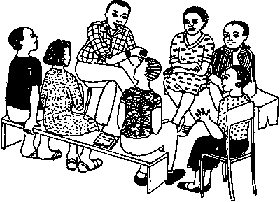
Workshop 5 – Internship Recap
Learning Outcomes
How has the program and job augmented or reinforced your adaptation skills and personal strengths
How can you apply this learning to your future
Delivery Techniques
Short individual class presentation or in a one-on-one interview

Slide 21
Internship
Students
Students are matched to internships based on their interest and aspirations
120 hours And unpaid
Must pass an interview with the host organization
Site visit by Internship Coordinator at midpoint
Host Organization
Will only be told that the student has a learning disability prior to student interview
Will be consulted on possible disability accommodation solutions
Must complete a performance evaluation
Notes:
Need to check legalities of disclosing criminal record

Slide 22
Questions?

Slide 23
References
Butler, D. L., Beckingham, B., & Novak Lauscher, H. J. (2005). Promoting strategic learning by eighth-grade students struggling in mathematics: A report of three case studies. Learning Disabilities Research & Practice, 20, 156-174.
DeLuca, C., Hutchinson, N. L., deLugt, J. S., Beyer, W., Thornton, A., Versnel, J., Chin, P., & Munby, H. (2010), Learning in the workplace: Fostering resilience in disengaged youth.
Goldberg, R. J., Higgins, E. L., Rashkind, M. H., Herman, K. L. (2003). Predictors of success in individuals with learning disabilities: A qualitative analysis of a 20-year longitudinal study. Learning Disabilities Research & Practice, 18, 222-236.
Quinn, M. M., Rutherford, R. B., Leone, P. E., Osher, D. M. & Poirier, J. M. (2005). Youth with Disabilities in Juvenile Corrections: A National Survey. Council for Exceptional Children, 71(3), 339-345.
Versnel, J., Hutchinson, N. L., Munby, H., & Chin, P. (2008). Work-based Learning for Adolescents with Learning Disabilities: Creating a Contest for Success. Exceptionality Education Canada, 18(1), 113-134.

