Slide 1
…Integrating Aboriginal Ways of Knowing
Gigi Hofer, Holly Schofield & Jennifer Tieche
April 2011
Notes:
For our portion of the class project, we chose not to concentrate on a program but rather on a population
– Aboriginals

Slide 2
Our objectives
1. Provide data on Aboriginal Youth in Canada today
2. Provide a theoretical lens from which to study Aboriginal programming in the future
3. Investigate Aboriginal ways of teaching and learning
Notes:
We have 5 main objectives under the umbrella of prevention
1. Provide data on Aboriginal Youth in Canada today
2. Provide theoretical lens from which to study Aboriginal programming in the future
3. Investigate Aboriginal ways of teaching and learning

Slide 3
Our objectives
4. Recognize such ways as legitimate
5. Consider how to respectfully & meaningfully marry Aboriginal ways with methods of practice in our current system of education
Notes:
4. Recognize such ways as legitimate
5. Consider how to respectfully & meaningfully
marry Aboriginal ways with methods of practice in our
current system of education

Slide 4
Canadian Census 2006
1,172,790 people self-identified as
First Nations, Metis or Inuit
3.8 percent of the Canadian population
Notes:
In 2006 the population of self-identified Aboriginals in Canada was nearly 1.2 million.
That’s 3.8% of the Canadian population

Slide 5
Western Canada
1 in 13 people in Western Canada are Aboriginal
Aboriginals are younger relative to non-Aboriginals
18% of Aboriginals in BC are between age 0-14
58% of Aboriginal children age 0-14 lived with
two parents, compared to 82 % of
non-aboriginal children
(Richards, 2008. Turpel-Lafond & Kendall, 2009)
Notes:
Majority of Aboriginal People live in Western Canada
A large % of that population is young,
but a smaller percentage of those young people live with both their parents than do their Non -AB counterparts

Slide 6
In 2006, of children
age 4 or younger in Western Canada, one in eight was Aboriginal.
Image free for use under creative commons licensing
Notes:
Of children age 4 or younger in Western Canada in 2006,
1 in 8 was Aboriginal.
These are our current elementary students .
The question is will they be our future secondary grads?

Slide 7
How do Aboriginal youth fit into the context of the broader project?
Notes:
So…how do Aboriginal youth fit into
the context of the broader project

Slide 8
Learning Disabilities
The concept of learning disabilities is at odds with the holistic framework of Aboriginal education.
Even the term identifies only a part of the child, the part that does not function well as a learner within the education system.
(Alberta Learning, 2005)
Notes:
Before we answer that question it’s important to mention…
We recognize that many Aboriginal students are labeled as having a disability – including LD
However, traditional Aboriginal worldviews see each individual holistically and as having a gift. The concept of LD is at odds with traditional ways because it identifies 1 part of the child.
So we have chosen to refrain from discussing LD in this presentation
Further info about #’s of Aboriginal children and youth w LD and other specific special needs
See census and the youth justice report in our supplemental resources

Slide 9
Department of Justice Canada
Snap Shot of Youth in Custody Phase II - 2003
Incarceration rate of Aboriginal youth: 64.5 per 10,000 population
Incarceration rate of non-Aboriginal youth: 8.2 per 10,000 population
(Paletta & Burnett, 2008)
Notes:
We are not narrowing our focus to struggling youth with LD but we recognize that
Aboriginal youth are struggling incredibly
AB youth are over represented in the Justice System
As are a youth with a disability of one kind or another
In 2003 department of Justice Canada took a snapshot of youth in custody
Incarceration rate of Aboriginal youth: 64.5 per 10,000 population
Incarceration rate of Non-AB youth: 8.2 per 10,000 population

Slide 10
Youth Justice Report 2009
collected data on all 50,551 children
born in 1986 who were attending
school in B.C. in 1997/98
focused on those living out side the
parental home who had become
involved with the youth justice system
Notes:
Looking specifically at BC
Office of Province Health & The Representative for Children and Youth collected data on all 50,551 children born in 1986 who were in school in 1997/98
The report is based on an extensive review of the outcomes of children and youth
involved in the youth justice system.
Goal : to understand risk factors and circumstances that lead to involvement with Youth Justice
Focused on those living out side the parental home – determined that to be risk factor

Slide 11
What they found about …
“A large and very vulnerable group
of children and youth,
many of whom are Aboriginal
and in the care of the government,
are at a higher risk of ending up
being involved
with the youth justice system.”
(Youth Justice Report, 2009)
Notes:
This is what they found:
Aboriginals and youth in care are at higher risk

Slide 12
Aboriginal Youth in Care
Over half of the children in care in B.C. are Aboriginal
1 in 5 Aboriginal youth had either been in care, in the home of a relative (or both) compared to less than 1 in 30
non-Aboriginal youth
        (Youth Justice Report, 2009)
Notes:
We know Aboriginals and youth in care are at risk
Over half of the children in care in B.C. are Aboriginal
1 in 5 Aboriginal youth had either been in care, in the home of a relative or both
compared to less than 1 in 30 Non-Aboriginal youth

Slide 13
Aboriginal Youth in Care
31.4% (nearly one third) of youth in the youth justice system are Aboriginal
(Youth Justice Report, 2009)
Notes:
Those at significant risk are those in care.
A large proportion of Aboriginals are in care in contrast to other Canadian children

Slide 14
Youth in the Justice System
A higher proportion of children and youth in care become involved with the youth justice system than graduate from high school
35.5 % as compared to 24.5%
(Youth Justice Report, 2009)
Notes:
14
In fact, higher proportion of children and youth in care become involved with the youth justice system than graduate from high school
35.5 % as compared to 24.5%
Sad reality is that this growing population, who are a young population
with higher fertility rates than non-Aboriginals (according to statscan data)
Have many of their children are in care, and involved with the justice system

Slide 15
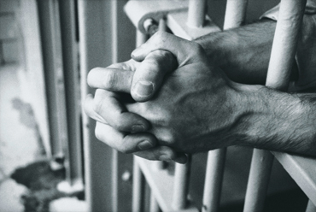
As Educators, how do we go from this…
(Madison, 2009)
Notes:
As educators, we must determine how to go from this…

Slide 16
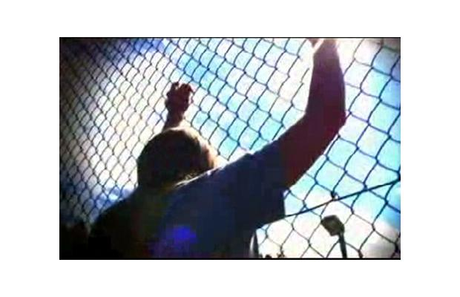
And this…
(Fournier & Province, 2011)
Notes:
And this…

Slide 17
To this…
(Morton & Augustine, 2010)
Notes:
To this…

Slide 18
To this…
Aboriginal Education Department for School District #22
Vernon
Notes:
And this…

Slide 19
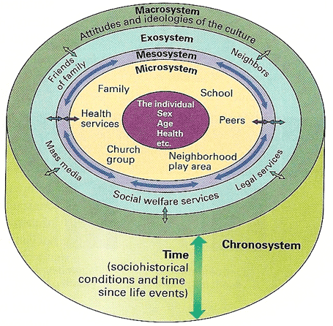
Bronfenbrenner’s Ecological Systems Theory
Notes:
To begin to answer this question, I’ll discuss two developmental theories that fit well with Aboriginal worldviews and issues.
The first is Bronfenbrenner’s Ecological Systems Theory.
In Bronfenbrenner’s theory, development reflects the influence of several environmental systems; in other words, a child’s unique development cannot be viewed without seeing the child in social and cultural contexts.
This is in line with the holistic worldview of Aboriginal communities, where a teacher is teaching not only the child, but a member of a family, a community and a culture.
As you can see, these systems are depicted as consecutive rings, starting with the setting the individual lives in and bound by the culture, with the chronosystem, or the sequencing of events over time running through all of the systems.
“some issues related to Aboriginal Youth clearly fall into these systems, specifically, those indicating relationships between contexts/ situations”…
19

Slide 20
Bronfenbrenner’s Ecological Systems Theory
Microsystem:
Mesosystem:
  Schools need to be an extension of the community (Battiste and McLean, 2005)
  Lack of parental and community involvement is a factor in Aboriginal student drop out
Notes:
First was the Microsystem or the setting where individual lives (family, school, peers, neighbourhood)
The second ring was the Mesosystem indicating relations between microsystems or connections between contexts (i.e. relation of family to school… such that poor relations with parents may influence interactions with teachers)
Considering these connections between contexts, Battiste and McLean argue that schools need to be an extension of the community.
In fact, lack of parental and community involvement is a factor in Aboriginal student drop-out
20

Slide 21
Bronfenbrenner’s Ecological Systems Theory
3. Exosystem:
  Research says interventions must begin with promoting healthy families and healing youth (Battiste and McLean, 2005)
Notes:
The third ring was the Exosystem or links between social systems in which the individual does not have direct control (i.e. child’s home experience may be influenced by mom’s work experience and this may influence school experiences)
Considering the impact of this large number of variables on the child, interventions need to be far-reaching and Battiste and McLean say that research indicates interventions must begin with promoting healthy families and healing youth.
21

Slide 22
Bronfenbrenner’s Ecological Systems Theory
4. Macrosystem:
  Eurocentric pedagogy which does not value Aboriginal learning theories means that Aboriginal youth must live between two opposing cultures
  Bicultural competence is having the skills, values and attitudes necessary to be successful in one’s traditional community a well as in the dominant culture (Crooks et al., 2009)
Notes:
The outside ring is the Macrosystem or the culture in which individual lives including SES and ethnicity
Some aboriginal scholars argue that Eurocentric pedagogy…
Bicultural competence is important because it will allow aboriginal youth to make positive and healthy choices. We think that bicultural competence is necessary both for aboriginal youth and for their educators.
22

Slide 23
Bronfenbrenner’s Ecological Systems Theory
5. Chronosystem:
- Healing the Soul Wound (Duran, 2006)
  “It’s where our parents are coming from. It’s where our grandparents are coming from. By the time you get to my generation, we have all the baggage and we don’t know where it comes from.” Kristen Hendrick, Elected Councillor, Chippewas on the Thames
Notes:
Finally, underlying these other systems is the Chronosystem, or the patterning of environmental events as they happen over time.
Recognizing that events occurring now are related to those in the past is very important when approaching issues surrounding Aboriginal youth.
Healing the soul wound talks about intergenerational trauma that’s been passed down from residential school students to their children, who pass it on to their children.
A relevant quote from a Chippewas Councillor:
23

Slide 24
School Attachment
What is it?
The degree to which a student has a sense of belonging to a school, not just in terms of fitting in but as a result of feeling valued and respected (Libbie, 2004)
  Aboriginal students report one of the main
  reasons for school drop out is the lack of respect accorded their culture
Notes:
Relation to Ecological Systems Theory: involves both social institutions (schools) and everyday environments (friends)
School Attachment is an appropriate theoretical framework to view Aboriginal youth because they have been found to lack connections with mainstream school systems.
What is school attachment? It’s the degree…
Respect is a major issue for Aboriginal students… they report that one of the main reasons for school drop-out is a lack of respect for their culture.
24

Slide 25
School Attachment
Relevant Factors
Friendships and peer relationships support school attachment (Ham and Faircloth, 2005)
    Feelings of marginalization and alienation reported contributing factors to school drop out (Battiste & McLean, 2005)
Notes:
25

Slide 26
School Attachment
Impact of Positive School Attachment
Improves academic self-efficacy
  Encountering racist attitudes that undermine self-esteem contributes to school drop out
Decreases mental health problems (Shochet et al., 2006)
Increase likelihood of graduation
Notes:
Improves academic self-efficacy (racist attitudes undermine self-esteem)
Decreases mental health problems
Increase likelihood of graduation: Aboriginal students are more likely to drop out of school than their non-aboriginal peers (Desroches, 2006)
26

Slide 27
School Attachment
Impact of Positive School Attachment Con’t
Reduces cigarette smoking, alcohol use, marijuana use, general delinquency and violent behavior (Dornbusch et al., 2001)
  Addiction rates higher in Aboriginal communities (DeLeeuw, Greenwood, & Cameron, 2010)

Slide 28
School Attachment
How it can be promoted
Fostering of a positive climate through teacher warmth, group projects and cooperative learning (Hill and Werner (2006)
  Within these activities Aboriginal learning styles need to be honoured
Teacher promotion of mutual respect (Anderman, 2003)

Slide 29
Aboriginal Ways of Knowing
(Kaminski, 2008)
THE IMPORTANCE OF ELDERS IN EDUCATION
STORY-TELLING IN EDUCATION
RESPECT
NOURISHING THE LEARNING SPIRIT
LEARNING WITH THE LAND
Notes:
29

Slide 30
Aboriginal Ways of Knowing
THE FOUR DIRECTIONS
CIRCLE TALKS
QUATERNITY
POSITIONALITY
EXPERIENTIAL KNOWLEDGE
Notes:
30

Slide 31
Aboriginal Ways of Knowing
MULTIPLE INTELLIGENCES or LITERACIES
INTERCONNECTEDNESS

Slide 32
Aboriginal Programming
Any effective program within a school setting must go beyond the “add-on and stir” model of education
  Imperative to place education into culture rather than continuing the practice of placing culture in education (Battiste & McLean, 2005)
Values and traditions of Aboriginal peoples support more holistic learning approaches honouring aboriginal learning styles
  Collaboration
  Visual
  Reflection (Crooks et al., 2009)
Notes:
FN Model of Experiential Learning (Smith and McGee 2005) – not necessarily a linear cognitive experience
Experiencing: Engagement in “real life” learning experience
Reflecting: Internalization of the Experience
Meaning Making: Analysis of the Experience
Acting: Application of Experience to other “real life’ situations
32

Slide 33
Principles for Enhanced Programming
Understanding & integrating cultural identity
  Cultural identity needs to be reflected in the school environment [i.e. Posters in school hallways, not simply related to issues of culture, but for any positive image – student leaders, etc. ] (Crooks et al., 2009)
  Different ways of knowing need to be incorporated and acknowledged (i.e. Sharing circles, peer tutoring and time for self-reflection rather than lecture formats as means of instruction and learning (Kaminski, 2008)

Slide 34
Principles for Enhanced Programming
Increasing youth engagement
  provide a range of roles and opportunities to become leaders in addition to participants (Crooks et al., 2009)
  Be flexible

Slide 35
Principles for Enhanced Programming
Fostering Youth Empowerment
  FN youth have responsibility of comprehending, learning and maintaining FN languages & cultures & must be given the opportunity & capacity to become leaders within their communities (Battiste & McLean, 2005)
  Mentoring is an excellent vehicle for youth empowerment; it recognizes that all individuals can learn from each other; and teaching is not limited to professional teachers (Crooks et al., 2009

Slide 36
Principles for Enhanced Programming
4. Establishing and maintaining effective partnerships
  Emphasis on extended family and social networks among Aboriginal cultures
  a source of cultural teachings
  increases ‘buy-in” from youth and the extended community (Crooks et al., 2009)
Notes:
Be mindful of differences in timelines and working styles
Credibility in working with Aboriginal partners will be based on how you conduct yourself (integrity, meeting commitments) rather than a title
36

Slide 37
In Summary
Dire state of Aboriginal youth
Theoretical Lens through which researchers can study the issues
View of marrying two authentic approaches to learning and ways of knowing
Notes:
In sum, our presentation discussed the dire state that many Aboriginal youth find themselves in in Canada.
We presented two theoretical lenses that academics can use to study Aboriginal youth.
And finally, we looked at Aboriginal education constructs with a view of marrying two authentic approaches to learning and ways of knowing.
37

