Slide 1
Evaluating Programs for Struggling Youth
EPSE 526
Notes:
INTRODUCTION – no need to modify

Slide 2
Goals
Find a way to evaluate programs that tackle issues facing struggling youth.
Uncover some of the common themes that make these programs successful.
Discuss implications for our current practices and future directions

Slide 3
Method of Evaluation
Notes:
INTRODUCTION – no need to modify

Slide 4
CASEL:
Collaborative for Academic and Social and Emotional Learning (CASEL)
Mission statement is to “establish social and emotional learning (SEL) as an essential part of education.”
Established in 1994 by Daniel Goleman, the author of Emotional Intelligence
Evaluate Social and Emotional Programs in their 2003 resource called Safe and sound: An educational leader’s guide to social and emotional learning programs
Notes:
INTRODUCTION – no need to modify

Slide 5
Example Framework
Evidence of Effectiveness
Academic Integration
Sound SEL Instruction
Professional Development
Classroom monitoring tools
Student assessment measures
School-wide coordination
School-family partnerships
School-community partnerships
Documented Behavioural Outcomes
Notes:
(self-regulations, perspective taking, conflict resolution, respect, positive relationships) - SEL

Slide 6


Grading System - MOONS
STRENGTH
PROMISING
MARGINAL
WEAKNESS

Slide 7
Program Evaluations
Roots of Empathy
Mosaic Education Solutions
Take a Hike Program

Slide 8

Roots of Empathy
Mary Reid, Laura Lopthien & Erin Alderson

Slide 9
Description of Program
ROE’s mission is “to build caring, peaceful and civil societies through the development of empathy in children and adults.”
ROE is an international, evidence-based classroom program for students in Kindergarten through Grade 8 that uses a baby as the “teacher”.
The baby visits every 3 weeks and the ROE instructor guides students in discussing the baby’s development and feelings. Students reflect on their own feelings and the feelings of others through a variety of emotional literacy activities revolving around the baby.
The instructor visits before and after each baby visit to reinforce teachings using specialized lesson plans from the ROE curriculum (there are 9 themes with 3 visits for each theme).

Slide 10
Description of Program
The goals of the program are to foster the development of empathy, develop emotional literacy, reduce levels of bullying/aggression/violence, increase knowledge of human development/infant safety, and to prepare students for responsible citizenship and responsive parenting
ROE teaches self-awareness, social awareness, self-management, relationship skills and responsible decision-making.
Academic activities include links with math, music, art and literacy.
The curriculum has been recommended by Curriculum Services Canada as a “valid program…to promote understanding of human development, diversity and the uniqueness of individuals.”

Slide 11
Evaluation of
Roots of Empathy

Slide 12
Program Criteria | Rating
Academic Integration
Evidence of Effectiveness
SEL Instruction
Professional Development
Classroom Monitoring Tools

Slide 13
Program Criteria | Rating
Student Assessment Measures
School-Wide Coordination
School-Family Partnerships
School-Community Partnerships
Documented Behavioural Outcomes

Slide 14
Strengths
Early intervention/prevention
Model of social innovation
Many aspects of the program are direct links to academic outcomes
Curriculum has been recognized by Curriculum Services Canada as promoting understanding of human development, diversity, and individuality
Promotes SEL
No additional work is required of the teacher
Research findings are supportive of the overall effectiveness of the program

Slide 15
Limitations
Often isolated to one classroom or one grade level within a school
No professional development available for classroom teacher
ROE instructors are not trained classroom teachers
Funding was cut for ROE in 2009, schools are now responsible to cover the cost of the program
Doesn’t seem to connect school-wide or with families
The only input that classroom teachers have is in the final online survey at the end of the program

Slide 16
Implications for Youth-at-Risk
Children who participate in ROE show:
  improved pro-social behaviour (helping, sharing, including others)
  increased levels of empathy (perspective taking, social/emotional understanding)
  decreased levels of aggression (violence, drug/alcohol abuse, crime, suicide attempts, high-school dropout)
  Lower levels of stress and depression
  Positive attitudes towards themselves and others
  Acceptance amongst peers
  Positive attitudes towards school
  Better grade point averages and standardized test scores
  Knowledge of important parenting skills

Slide 17
References
http://www.rootsofempathy.org/
Gordon, M. (2005). Roots of empathy: Changing the world
child by child. Toronto: Thomas Allen Publishers.

Slide 18
Mosaic Education Solutions
Linh, Kim Grimwood, Lindsay Willms

Slide 19
Description of Mosaic Education Solutions
Notes:
Linh

Slide 20

Services:
Professional Development Workshops
Parent Workshops
Consultation Services (wrap-around service, transition planning, IEP meetings, “Mosaic Education Planning,” referral
Notes:
Lindsay

Slide 21
Evaluation of
Mosaic Education Solutions

Slide 22
Program Criteria | Rating
Academic Integration | A / T
Evidence of Effectiveness
SEL Instruction
Professional Development
Classroom Monitoring Tools
Notes:
Kim
A – applies SEL to academic content
T – promotes change in teaching strategies

Slide 23
Program Criteria | Rating
Student Assessment Measures
School-Wide Coordination
School-Family Partnerships
School-Community Partnerships
Documented Behavioural Outcomes | Non-documented ACAD (academic) and SOC (social behaviours)
Notes:
Kim

Slide 24

Strengths
Individualized approach for each student
  Responds to learning and social emotional needs
  Whole child approach
Wrap-around approach to intervention evidence-based:
  Eber, Sugai, Smith and Scott (2002) see wraparound as a planning process “used to build consensus within a team of professionals, family members, and natural support providers to improve the effectiveness…of supports and services from children and their families.” (p. 173)
Sarah Howard,
Mosaic Education Consultant
“If a child’s highest risk is the learning pieces, we need to look more at all the other pieces and how we can address those through a multi-faceted approach with a multi-disciplinary team.”
(Sarah Howard, March 28, 2011)
Notes:
Lindsay

Slide 25
Strengths
Sarah Howard,
Mosaic Education Consultant
Emphasizes need for transition planning
  Weidenthal and Kochhar-Bryant (2007) states that early and ongoing transition planning reduces student alienation, improve attendance and prevents school dropout. Youth with disabilities are at the greatest risk.
Notes:
Linh

Slide 26
Strengths
Promotes student self-advocacy and parent advocacy
  Weidenthal and Kochhar-Bryant (2007) claims that students who are engaged in self-determination activities also take greater responsibility for their lives after high school.
  Ensuring that family members remain connected and engaged with the student and school helps to prevent students with disabilities from dropping out of high school (Test et al., 2009).
  According to Fiedler and Danneker (2007), students with self-advocacy skills are better able to transition to post-secondary education and other adult pursuits including employment and social connections
Sarah Howard,
Mosaic Education Consultant
“I always go in with the attitude of ‘I am here to help the family interpret what’s happening, I am not here to tell you what to do.’”
(Sarah Howard, March 28, 2011)
Notes:
Kim

Slide 27

Strengths
Able to connect with families, students and teachers around the globe through the use of webinars and web-conferencing
Targets families, students and teachers (through professional development)
Notes:
Lindsay

Slide 28

Limitations
Program has not been
evaluated
Difficulty in reaching a
wide group of at-risk
youth (one-to-one
services)
Notes:
Kim

Slide 29

Limitations
Expense:
  Difficult for many families to afford consulting
  Difficult for families to follow some suggestions for private options (eg: Fraser Academy or Eton-Arrowsmith)
“A lot of the families whose kids end up becoming more high risk have those multiple factors including socio-economic status...and the private options become unavailable.” (Sarah Howard, March 28, 2011)
Notes:
Kim

Slide 30

Limitations
Motivation:
  Why are students going to a consultancy?
  Is there student buy-in?
Notes:
Linh
-out of 11 students last year, 2 were not motivated and as such, did not make progress though Mosaic services

Slide 31
Implications for Youth-at-Risk
Public school system could benefit from a Mosaic-like approach to better serve youth-at-risk
There is a lack of knowledge about effective programs to meet students unique needs
Our education system needs to become more flexible in what it is able to offer our students in terms of options
Notes:
Lindsay

Slide 32
Implications for Youth-at-Risk
There needs to improved communications across and between:
  School districts
  Support workers and teachers
  Communities
  Families
  Students
Notes:
Lindsay

Slide 33
References
Eber, L., Sugai, G., Smith, C., & Scott, T. (2002). Wraparound and positive behavioral interventions and supports in the schools. Journal of Emotional and Behavioral Discorders. 10, 171-180.
Fiedler, G.R. & Danneker, J.E. (2007). Self-advocacy instruction: bridging the research-to-practice gap. Focus on exceptional children, 39, 1-20.
Test, D., Fowler, C., White, J., Richter, S., & Walker, A. (2009). Evidence-Based Secondary Transition Practices for Enhancing School Completion. Exceptionality, 17, 16-29.
Weidenthal, C. & Kochhar-Bryant, C. (2007). An Investigation of Transition Practices for Middle School Youth. Career Development for Exceptional Individuals, 30, 147-157.

Slide 34
Take A Hike
Rose Atkins, Kate Kelsey and Marty Routley
Notes:
(Marty)

Slide 35
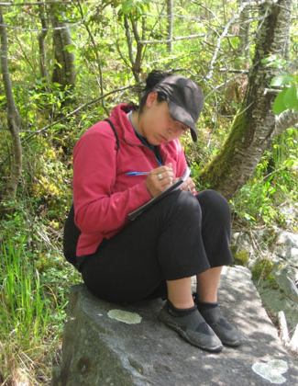
Introduction / Overview
Adventure Based Learning
Take A Hike (TAH)
CASEL Ratings for TAH
TAH Strengths & Limitations
More Research Required
Implications for Youth at Risk
Conclusions and Recommendations
Notes:
(Marty)
Marty - #1, 2
Rose - #3, 4
Kate - #5, 6, 7

Slide 36
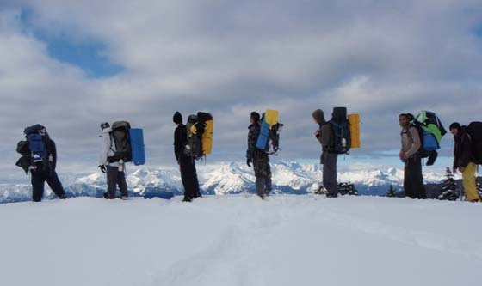
Adventure Based Learning (ABL)
“Adventure-based learning is a type of educational and/or therapeutic program in which adventure pursuits that are physically and/or psychologically demanding are used within a framework of safety and skills development to promote interpersonal and intrapersonal growth.”
(Nadler & Luckner, 1992, p. 7)
Notes:
(Marty)
-Also known as adventure education and adventure therapy
-Incorporates the concept of experiential education “people learn best by direct and purposeful contact with their learning experiences”

Slide 37
Adventure Based Learning (ABL)
Positive self-perception
Increased knowledge, skills, and abilities
Positive peer relationships and social skills
Novelty and “escape”
  New environments (removal from everyday stressors)
  New Perspectives
  Structure
Focus on teamwork
Risk-taking and Challenge
Duration and intensity
Notes:
(Marty)
-Studies have shown that there are many benefits to ABL
-ABL can have positive influences on students in many different ways
-Many ABL programs offer wilderness trips that integrate curriculum and offer therapy

Slide 38
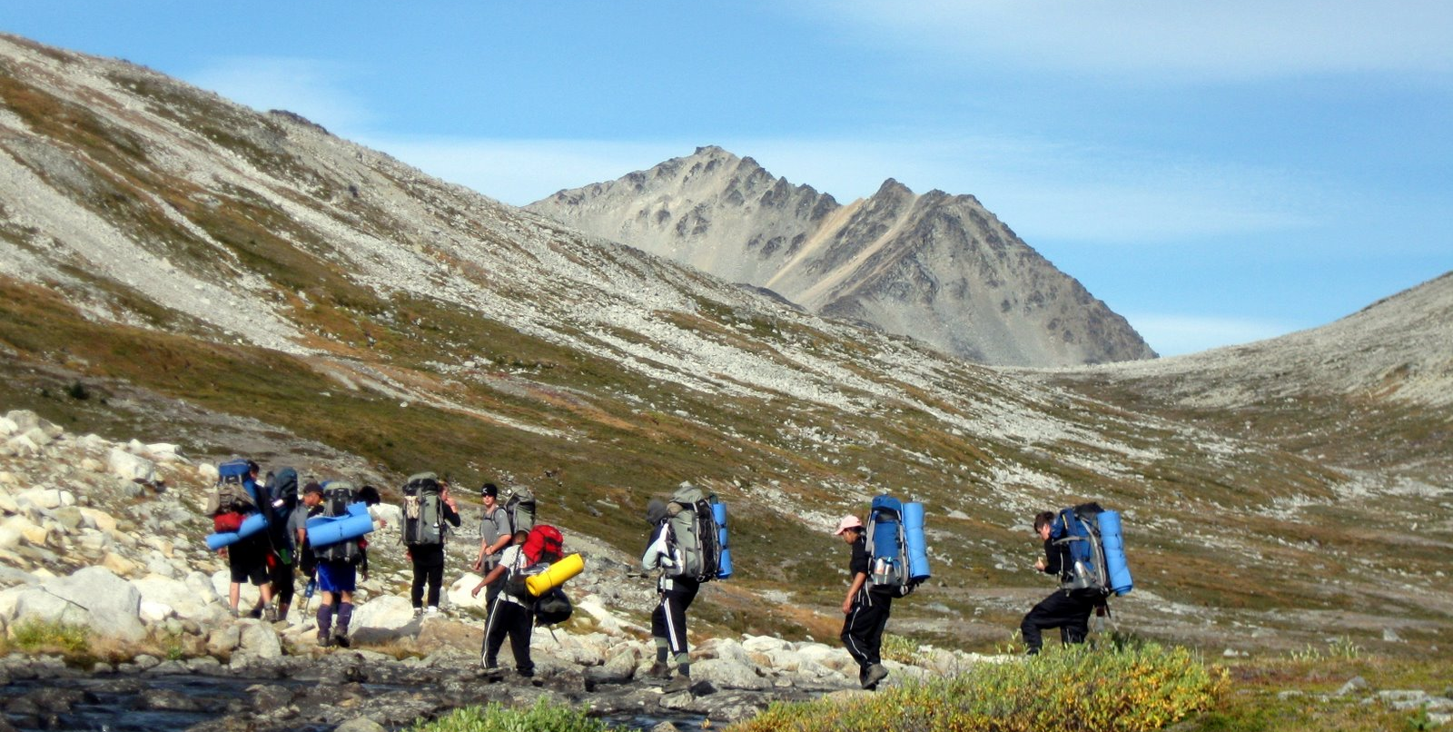
ABL and Take a Hike
“Adventure-based learning uses physical activities to help youth develop self-directed goals, trust, communication, teamwork and problem-solving skills. It also provides a safe and supportive environment for building self-esteem and self-motivation, and is instrumental to the successful turnaround of students' lives.”
(Take a Hike Youth at Risk Foundation, 2011b, para. 1)
Notes:
(Marty)
-Adventure-based Learning (ABL): An ABL Specialist guides students through outdoor day trips and multi-day expeditions. ABL uses physical activities to help youth develop self-directed goals, trust, communication, teamwork and problem-solving skills in a safe, supportive environment.

Slide 39

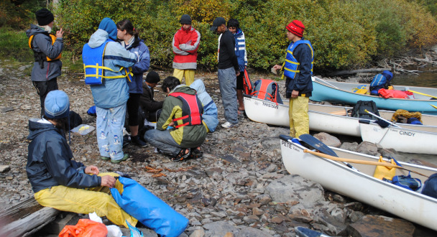
Take A Hike
“Take a Hike is an alternative education program that engages at-risk youth through a unique combination of adventure-based learning, academics, counseling, and community involvement.”
(Take a Hike Youth at Risk Foundation, 2011a, para. 1)
Notes:
(Marty)
-Alternative adventure education school established in 2000
-Partnership between the Take a Hike Youth at Risk Foundation and the Vancouver School Board
-40 Gr. 10-12 students who are considered ‘at risk’ – i.e. Drug and/or alcohol addiction, Physical/mental abuse, Criminal activity, Low self-esteem, Depression, Trauma---Most students referred by school counselors or social workers
-Relies on private funding $350 000 per year

Slide 40
Take a Hike
Notes:
(Marty)
Therapy: Two program therapists provide youth with individual, group, and family counseling in both outdoor and office settings. The therapists aim to change the negative impact the past has on the present, become a better choice maker, increase self-esteem and accept and take responsibility for their own actions.
Academics: At the beginning of the year, the Take a Hike staff meet with each student to assess their academic level and work with them to plan a path that leads to graduation.The outdoor trips also serve to reinforce academic lessons.
Community Involvement: Every student in the Take a Hike program performs a minimum of 60 hours of community service a year. The purpose is to demonstrate to youth that, as members of a larger community, they have a responsibility to others and that their help is needed. Valuable work experience is also gained.”

Slide 41
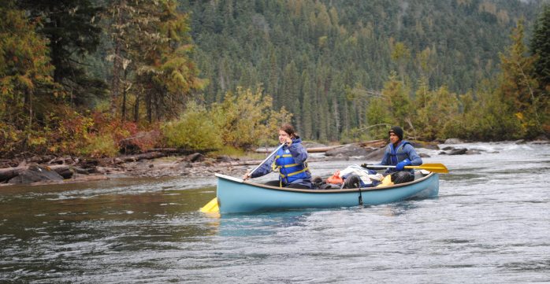
Take a Hike
“The ultimate goal of the Take a Hike alternative education program is that barriers to learning are minimized, personal issues are addressed, and students achieve a greater level of social and academic success.”
(Take a Hike Youth at Risk Foundation, 2011a, para. 5)
Notes:
(Marty)
Quotes
-“I've learned a lot and how to work with my peers cooperatively by listening to what my team has to say.”
-“I now feel that school is a positive and comfortable learning environment.”
-“I see myself better than I used to. I used to feel like I was going nowhere but there's a chance now for me to be successful.”
41

Slide 42
Evaluation of
Take a Hike
Notes:
(Rose)

Slide 43
Program Criteria | Rating
Academic Integration | A, C, T
Evidence of Effectiveness
SEL Instruction | (Insufficient information)
Professional Development
Classroom Monitoring Tools | (Insufficient information)
Notes:
(Rose)
Academic Integration:
TAH receives an A, C, and T rating, as it:
Applies SEL to academic content (A),
Provides content promoting SEL (C), and
Promotes changes in teaching strategies (T)
Evidence of Effectiveness:
While there was no specific research on Take a Hike, we were able to find other literature that supports programs based on adventure-based learning (as was previously discussed)
SEL Instruction:
Five areas of SEL Competencies: Self-Awareness, Emotion Regulation, Social Awareness, Relationship Skills, Responsible Decision Making
Unfortunately we were not able to obtain the information required to offer a rating in this area.
Professional Development:
This area receives a full moon, as there is continual professional development
Classroom Monitoring Tools:
Unfortunately we were not able to obtain the information required to offer a rating in this area.
However, as it is a school, the program and teachers would be held accountable by the ministry of education and we imagine that this would involve fairly structured monitoring of program delivery.

Slide 44
Program Criteria | Rating
Student Assessment Measures
School-Wide Coordination
School-Family Partnerships
School-Community Partnerships
Documented Behavioural Outcomes | (No formal reviews of TAH program)
Notes:
(Rose)
Student Assessment Measures:
Ongoing performance based assessment
School-Wide Coordination:
We gave this area a full moon, as all staff involved in the TAH program from therapists to teachers, are involved in the teaching and facilitation of SEL skills
School-Family Partnerships:
This area also receives a full moon, as there is a strong structure for consistent family involvement, including family counseling, consistent communication, and a website with program resources to help families stay connected to the program.
School-Community Partnerships:
This area receives a full moon. Community service is one of the 4 components of the program; therefore, there is “structure provided for ongoing school-community participation” (CASEL)
Documented Behavioural Outcomes:
As no research has been done on TAH, there are no formally documented behavioural outcomes; however, from our understanding of the program, it would most likely benefit the following areas: academic, substance abuse prevention, violence prevention, general health promotion, and other social behaviours.

Slide 45
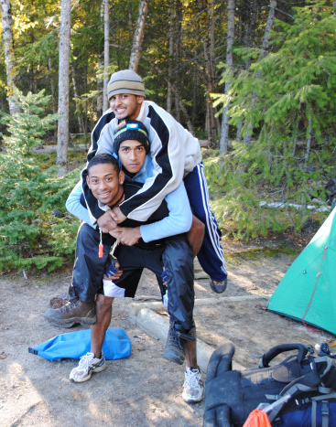
Strengths
Prevention and intervention
Access to therapy
Collaborative approach
Comprehensive program
  Dogwood
  Lifeskills
  Therapy
  Community involvement
  Increased public awareness
Notes:
(Rose)
Prevention and intervention
Access to therapy
Collaborative approach
Comprehensive program
Dogwood
Lifeskills
Therapy
Community involvement
Increased public awareness

Slide 46

Limitations
Lack of research
Dependant on private funding
Limited available space
Application process
Notes:
(Rose)
Lack of research – on ABL in general and TAH specifically
Dependant on private funding
Limited available space – only 40 students
Application process – could intimidate some students

Slide 47
More Research Required
Documentation of Adventure Education programs has recently increased
Lack of accredited programs and quantitative studies
Difficult for this area of education to have a distinct identity and be seen as respected area of education
Without more research and a distinct identity, Adventure Education programs are:
  Viewed as adjunct programs
  At risk for continued lack of support
Notes:
(Kate)
Adventure education programs have recently increased the amount and quality of documentation of their programs
Regardless of this improvement, there is still a lack of accredited programs and quantitative studies in this area
Lack of fidelity makes it difficult for this area of education to have a distinct identity that could become a respected area of education
Without the follow through of the items noted above, adventure education programs will continue to be viewed as adjunct programs and are at risk for continued lack of support

Slide 48
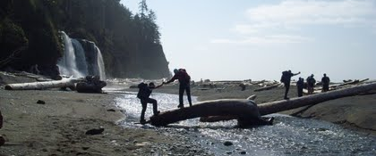
Implications for Youth-at-Risk
Innovative – new experiences
Removes students from contexts
Comprehensive and collaborative approach – everything in one place/setting
Notes:
(Kate)
Innovative – new experiences
Removes students from contexts
Comprehensive and collaborative approach – everything in one place/setting
Communication between staff members (as opposed to separate therapists, teachers, tutors, etc.)

Slide 49
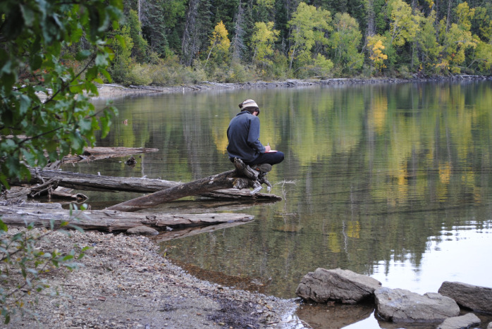
Conclusion and Recommendations
ABL’s identity
Accessibility
Adaptability of ABL principles: practical applications for classroom teachers?
Notes:
(Kate)

Slide 50

Take a Hike Video
(Full video can be found online at: http://www.youtube.com/watch?v=3g8uxJWhFR4)
Notes:
(Kate)

Slide 51
References
Bobilya, A. J., & Akey, L. D. (2002). An evaluation of adventure education components in a residential learning community. The Journal of Experiential Education, 25(2), 296-304.
Fire & Light Media Group . (2010, October 27). Take a Hike 10th Anniversary Video [Video file]. Retrieved from http://www.youtube.com/watch?v=3g8uxJWhFR4 Garst, B., Scheider, I., & Baker, D. (2001). Outdoor adventure program participation impacts on adolescent self-perception. Journal of Experiential Education, 24(1), 41-49.
Long, A.E. (2001). Learning the ropes: Exploring the meaning and value of experiential education for girls at risk. Journal of Experiential Education, 24(2), 100-108.
Nadler, R. S., & Luckner, J. L. (1992). Processing the adventure experience. Dubuque, IA: Kendall/Hunt.
Take a Hike Youth at Risk Foundation. (2011a). About the Program. Retrieved March 12, 2011, from Take a Hike Youth at Risk Foundation: http://www.takeahikefoundation.org/?page=program
Take a Hike Youth at Risk Foundation. (2011b). Adventure-based Learning. Retrieved March 12, 2011, from Take a Hike Youth at Risk Foundation: http://www.takeahikefoundation.org/?page=adventure
Tucker, A., & Rheingold, A. (2010). Enhancing fidelity in adventure education and adventure therapy. The Journal of Experiential Education, 33(3), 258-273.

Slide 52

Any Questions?

